Slide 1
System Design Characteristics: Availability, Reliability, Scalability: Vertical Scaling (Scaling Up), Horizontal Scaling (Scaling Out)
System Design(SD)(22CS024)
Bachelor of Engineering- Computer Science & Engineering
Department of Computer Science & Engineering
Chitkara University Institute of Engineering and Technology, Chitkara University, Punjab, India

Slide 2
AVAILABILITY and RELIABILITY
In system design, availability refers to the system's ability to be accessed and operational when needed, while reliability refers to its consistent and dependable performance over time.
High availability means minimal downtime, while high reliability means consistent, error-free operation. They are related but distinct concepts; availability focuses on uptime, while reliability focuses on the quality of that uptime.

Slide 3
AVAILABILITY
Availability in system design essentially measures how often a system is accessible and operational for users.
It's often expressed as a percentage, representing the proportion of time the system is available over a given period.
Factors like hardware failures, network issues, and even software bugs can affect availability.
High availability is crucial for user satisfaction and revenue protection, as it ensures users can access the system when they need it. Achieving high availability often involves redundancy, failover mechanisms, and robust monitoring systems.

Slide 4
RELIABILITY
Reliability, on the other hand, focuses on the consistency and dependability of a system's performance.
It measures the likelihood that the system will perform its intended function correctly over a specified period, under stated conditions.
A reliable system consistently delivers correct results and minimizes errors or failures.
Reliability is often measured by metrics like Mean Time Between Failures (MTBF). Building a reliable system involves meticulous design, robust testing, and proactive maintenance.

Slide 5
AVAILABILITY and RELIABILITY cont…
A system can be highly available (lots of uptime) but unreliable (prone to errors), or it can be reliable (performing tasks correctly) but have limited availability (frequent downtime).
The goal is to achieve a balance between both, creating a system that is both accessible and consistently performs as expected.
Key Differences | Availability | Reliability
Focus | Availability centers on accessibility | Reliability emphasizes consistent performance.
Measurement | Availability is measured as a percentage of uptime | Reliability is often expressed as a probability or mean time between failures (MTBF).
Time frame | Availability is typically measured over extended period | Reliability can be assessed for specific operational durations.

Slide 6
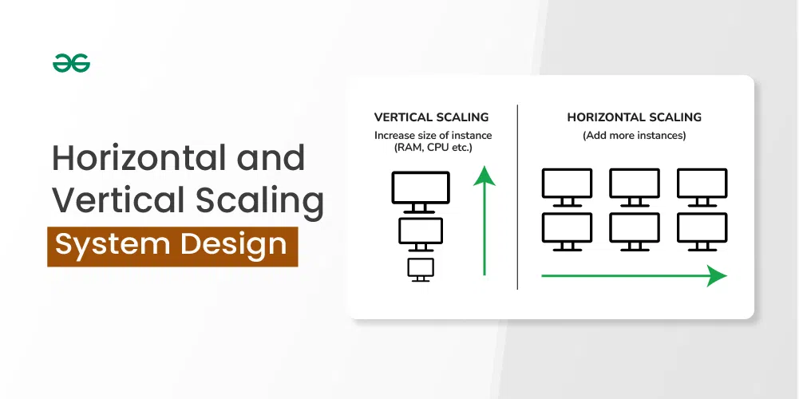
Horizontal and Vertical Scaling | System Design
In system design, scaling is crucial for managing increased loads. This article explores horizontal and vertical scaling, detailing their differences. Understanding these approaches helps organizations make informed decisions for optimizing performance and ensuring scalability as their needs evolve
Horizontal scaling and vertical scaling are two different approaches to scaling a system, both of which can be used to improve the performance and capacity of the system.

Slide 7
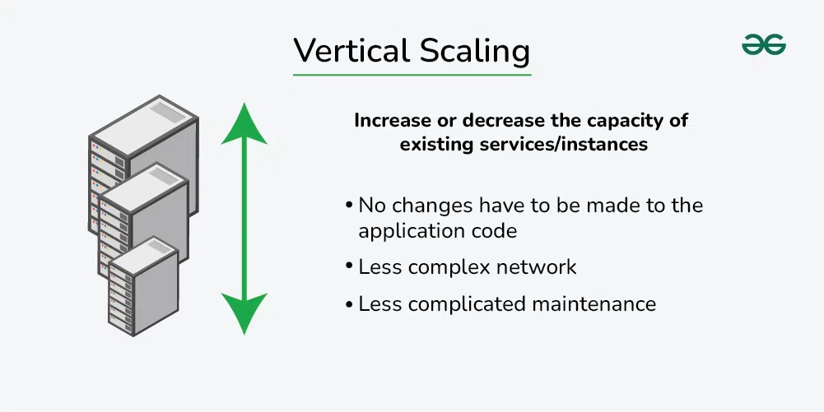
What is Vertical Scaling?
Vertical scaling, also known as scaling up, refers to the process of increasing the capacity or capabilities of an individual hardware or software component within a system.
You can add more power to your machine by adding better processors, increasing RAM, or other power-increasing adjustments.
Vertical scaling aims to improve the performance and capacity of the system to handle higher loads or more complex tasks without changing the fundamental architecture or adding additional servers.

Slide 8
Characteristics of the Vertical Scaling
This approach is also known as the ‘scale-up‘ approach.
It doesn’t require any partitioning of data and all the traffic resides on a single node with more resources.
Its implementation is easy.
Less administrative effort as you need to manage just one system.
Application compatibility is maintained.
Mostly used in small and mid-sized companies.
MySQL and Amazon RDS is a good examples of vertical scaling.

Slide 9
Adavantages and Disadvantages of Vertical Scaling
Below are the Adavantages and Disadvantages of Vertical Scaling:
Advantages of vertical scaling
Increased capacity: A server's performance and ability to manage incoming requests can both be enhanced by upgrading its hardware.
Easier management: Upgrading a single node is usually the focus of vertical scaling, which might be simpler than maintaining several nodes.
Disadvantages of vertical scaling:
Limited scalability: While horizontal scaling can be readily extended by adding more nodes and vertical scaling is constrained by the hardware's physical limitations.
Increased cost: It may be more costly to upgrade a server's hardware than to add extra nodes.
Single point of failure: One server still receives all incoming requests thus increasing the possibility of downtime in the event of a server failure.

Slide 10
What is Horizontal Scaling?
Horizontal scaling, also known as scaling out, refers to the process of increasing the capacity or performance of a system by adding more machines or servers to distribute the workload across a larger number of individual units.
In this approach, there is no need to change the capacity of the server or replace the server.
Also, like vertical scaling, there is no downtime while adding more servers to the network.

Slide 11
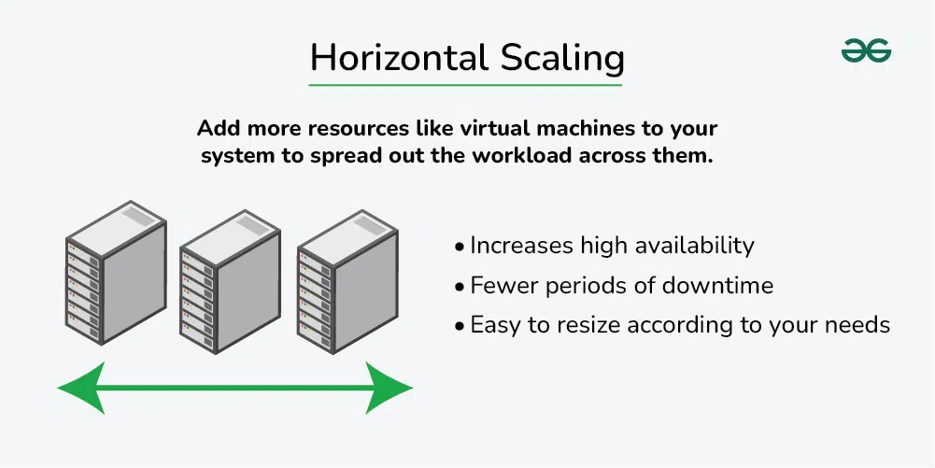

Slide 12
Characteristics of the horizontal scaling
This approach is also known as the ‘scale-out’ approach.
Horizontal scalability can be achieved with the help of a distributed file system, clustering, and load–balancing.
Traffic can be managed effectively.
Easier to run fault tolerance.
Easy to upgrade.
Easy to size and resize according to your needs.
Implementation cost is less expensive compared to scaling up.
Google with its Gmail and YouTube, Yahoo, Facebook, eBay, Amazon, etc. are heavily utilizing horizontal scaling.
Cassandra and MongoDB are good examples of horizontal scaling.

Slide 13
Adavantages and Disadvantages of Horizontal Scaling
Below are the Adavantages and Disadvantages of horizontal Scaling:
Advantages of horizontal scaling
Increased capacity: More nodes or instances can handle a larger number of incoming requests.
Improved performance: By distributing the load over several nodes or instances, it is less likely that any one server will get overloaded.
Increased fault tolerance: Incoming requests can be sent to another node in the event of a node failure, lowering the possibility of downtime.
Disadvantages of horizontal scaling
Increased complexity: Managing multiple nodes or instances can be more complex than managing a single node.
Increased cost: Adding more nodes or instances will typically increase the cost of the system.

